Slide 1

ABA ANALYSIS & CONSULTING
BY VISA:
Anh Vo, Thai Huynh, Lynn Nguyen, Annie Nguyen

Slide 2
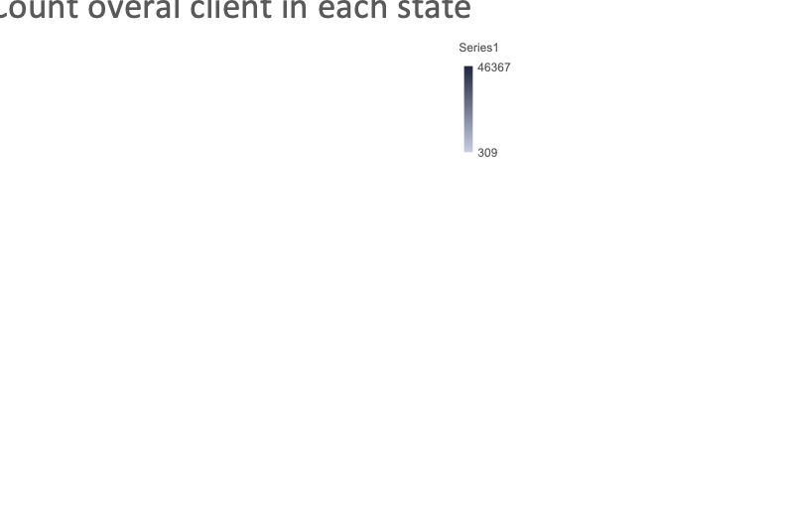

Slide 3
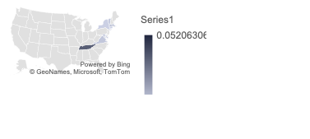
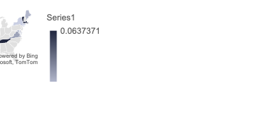

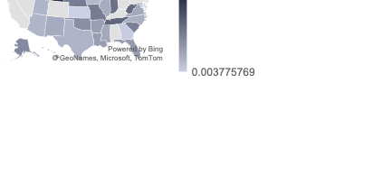

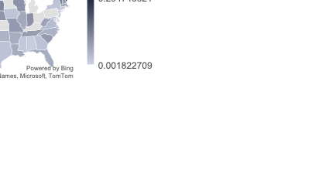

Client Analysis

Slide 4
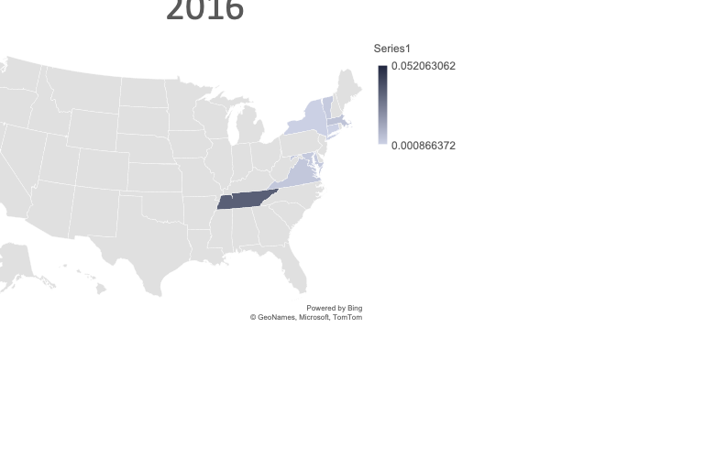

Slide 5
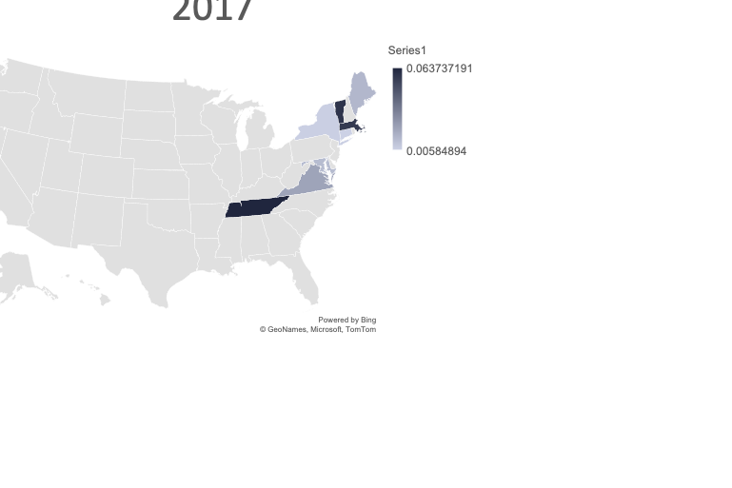

Slide 6
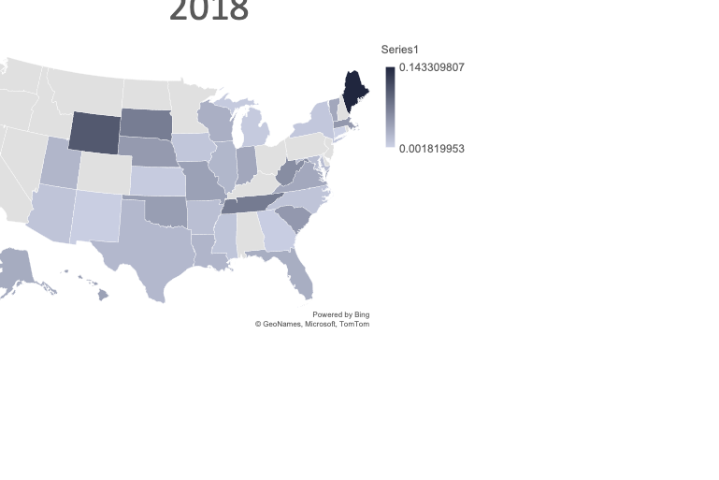

Slide 7
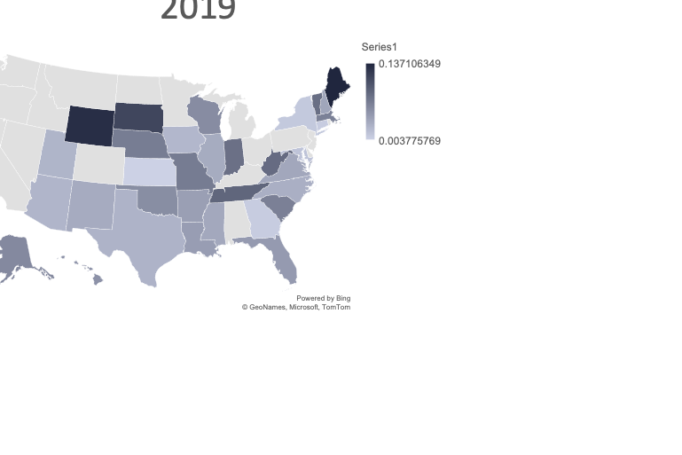

Slide 8
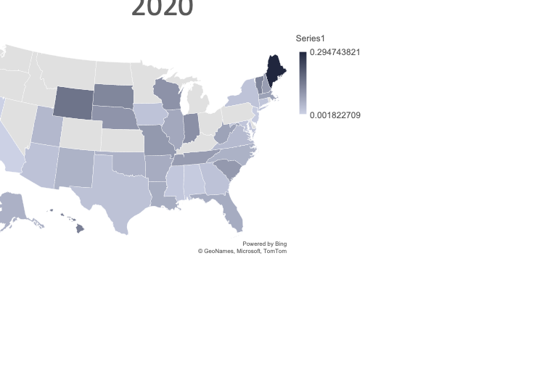

Slide 9
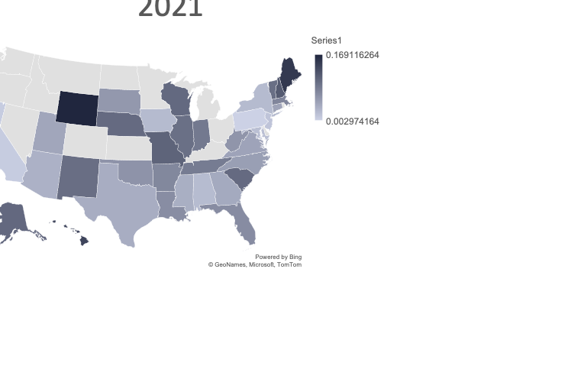

Slide 10
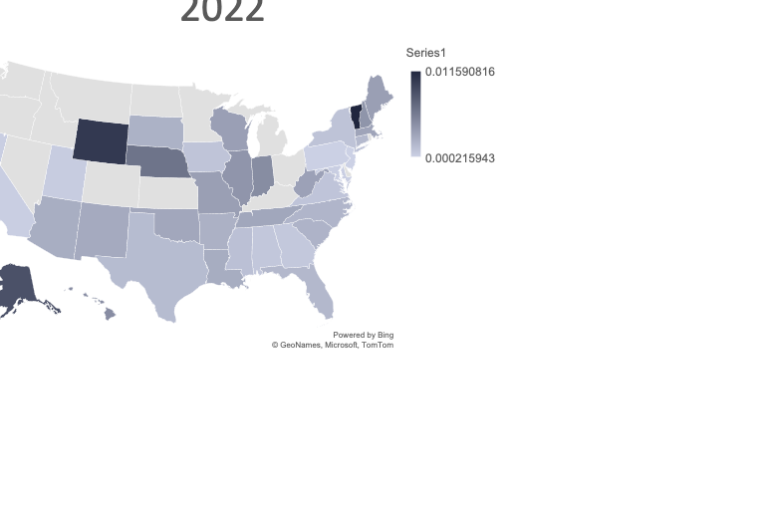

Slide 14
Work, Employment, Unemployment
Other
Health and Disability
Family and Children
Education
Consumer Financial Question
Juvenile
Individual Right
Income Maintenance
Housing and Homelessness
Categories Frequent Asked

Slide 15
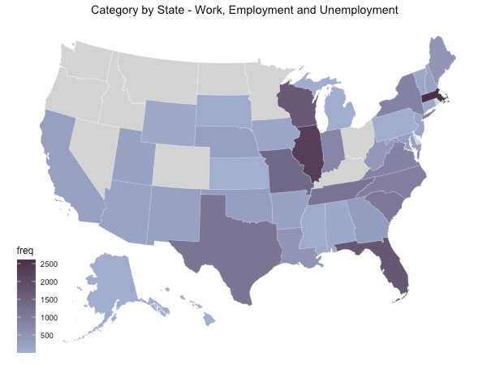

Slide 16
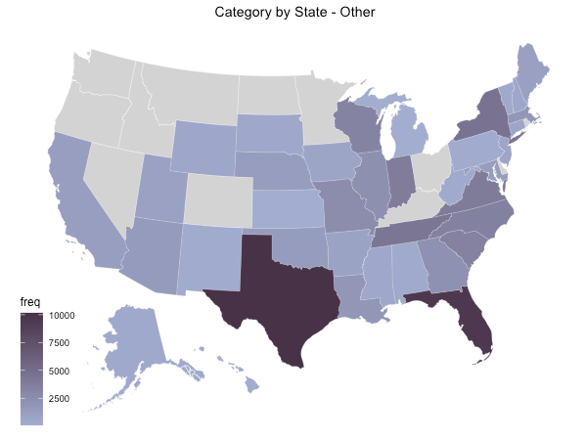

Slide 17
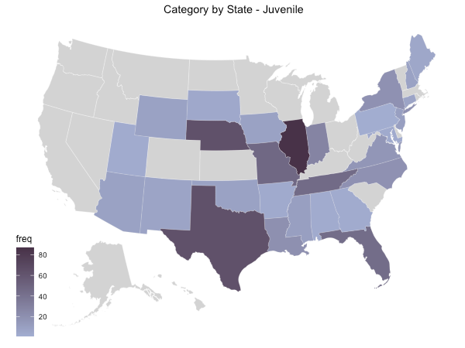

Slide 18
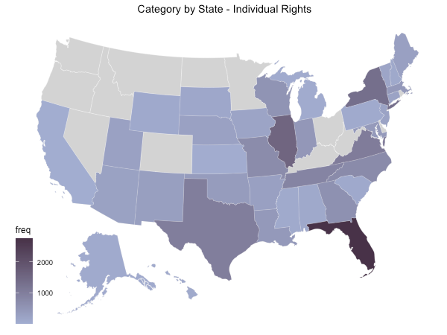

Slide 19
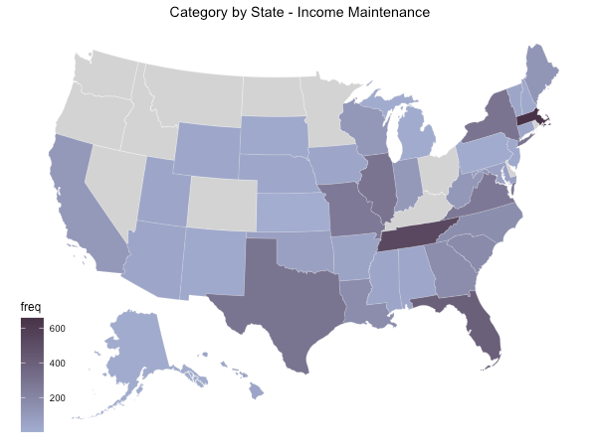

Slide 20
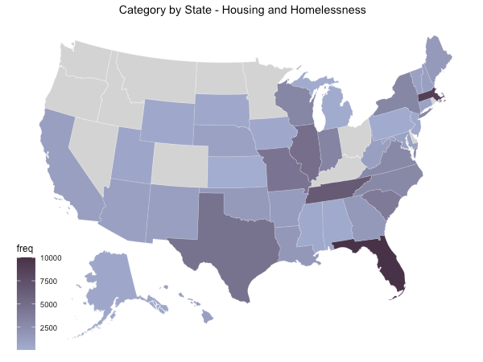

Slide 21
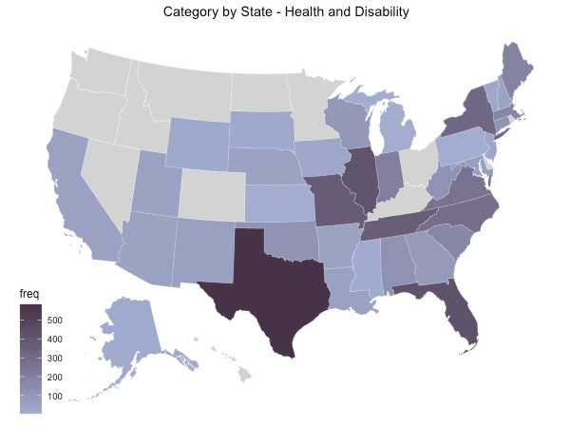

Slide 22
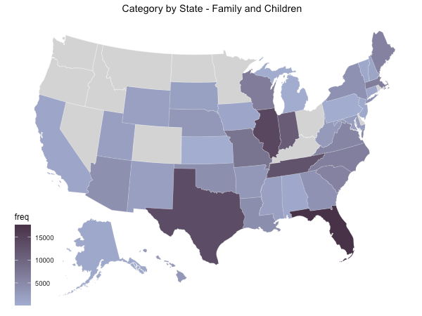

Slide 23
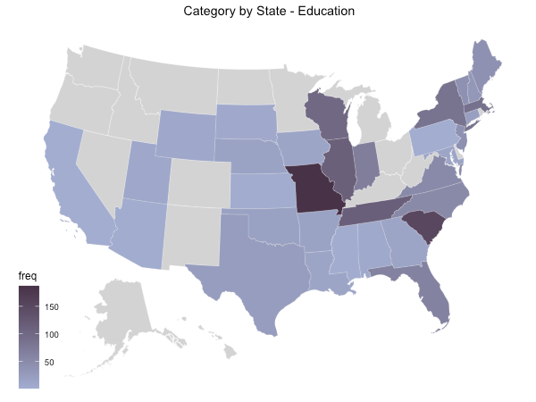

Slide 24
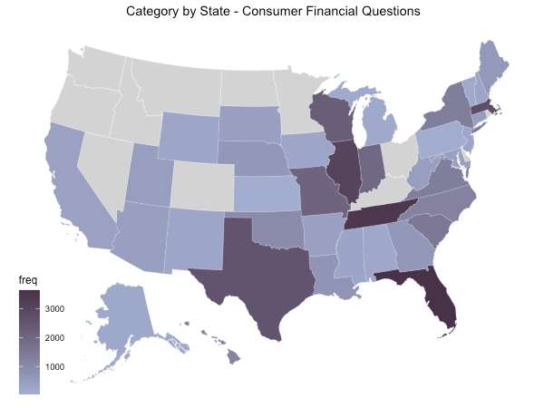

Slide 25
CONSULTING

Slide 26
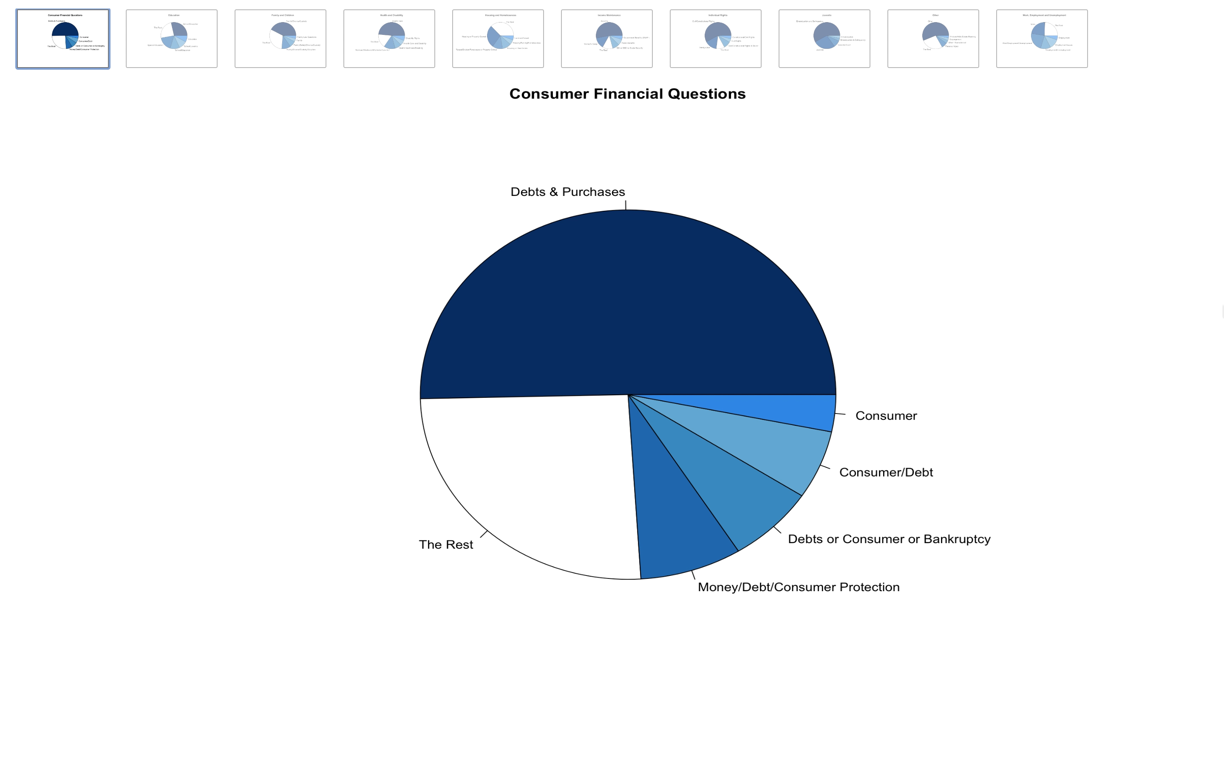

Slide 27
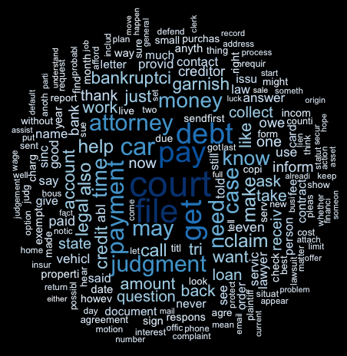
Consumer Financial Questions

Slide 28
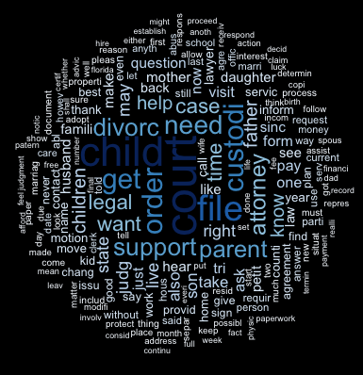
Family and Children

Slide 29
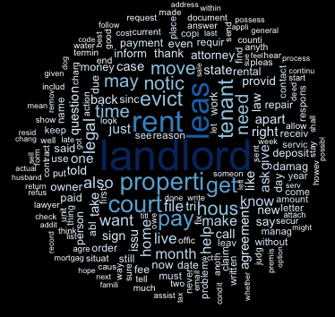
Housing and Homelessness

Slide 30
Consumer Financial Question
Family and Children
Housing and Homelessness
Health and Disabillity
Income Maintanence
Individual Rights
Work, Employment, Unemployment
Education
Juvenile

Slide 31
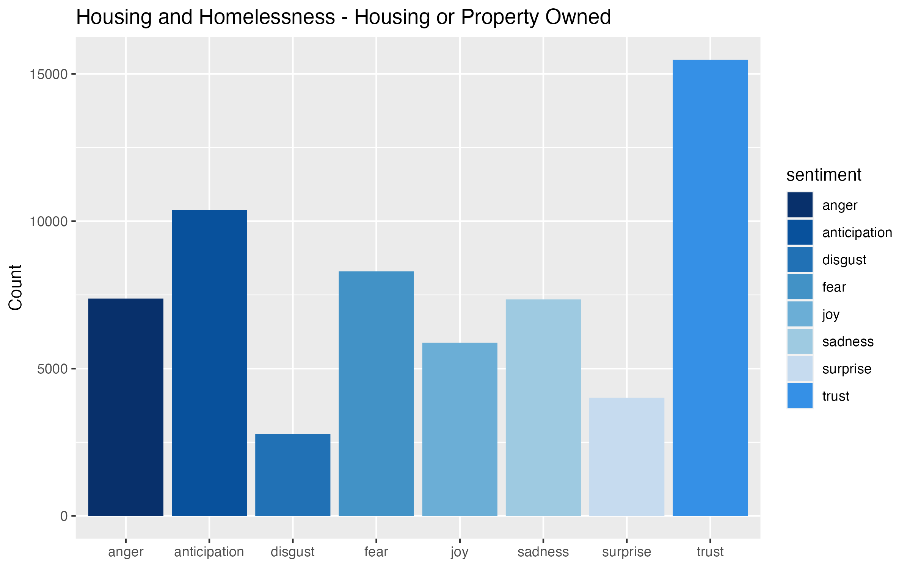
Consumer Financial Questions

Slide 32
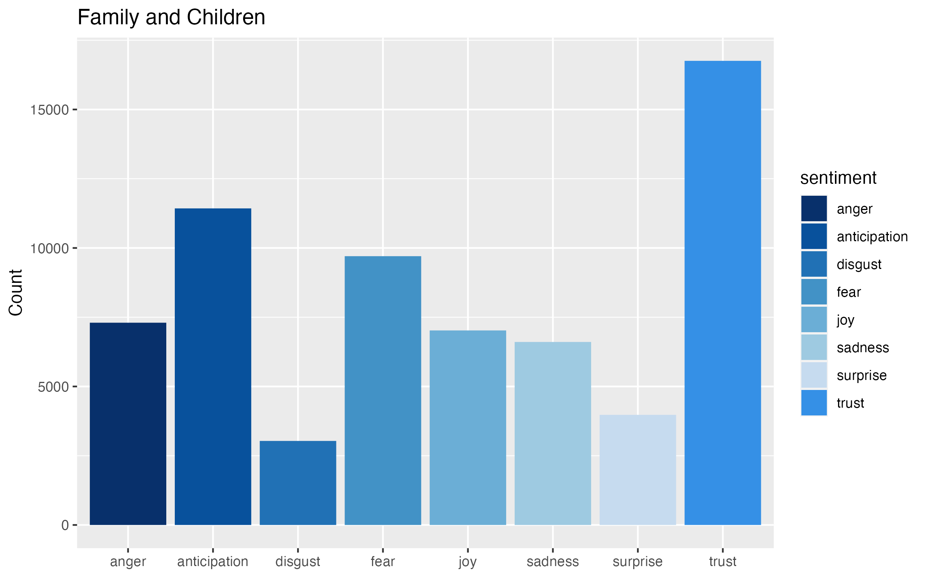

Slide 33
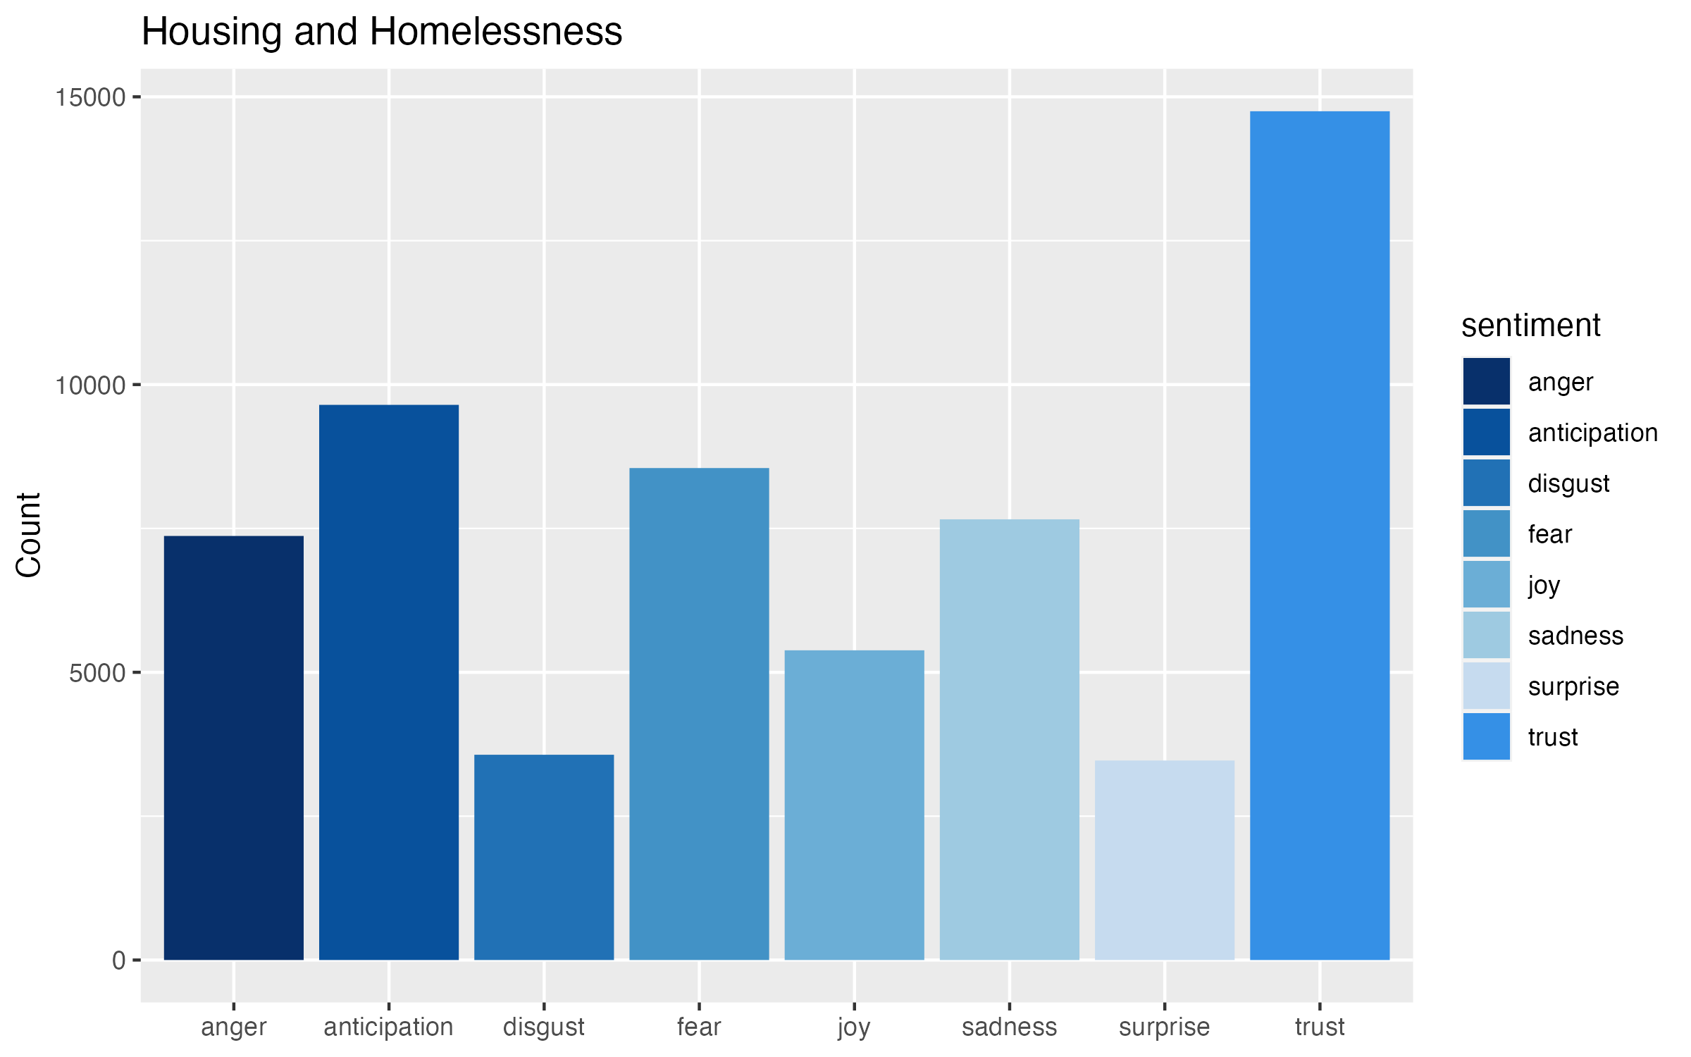

Slide 34
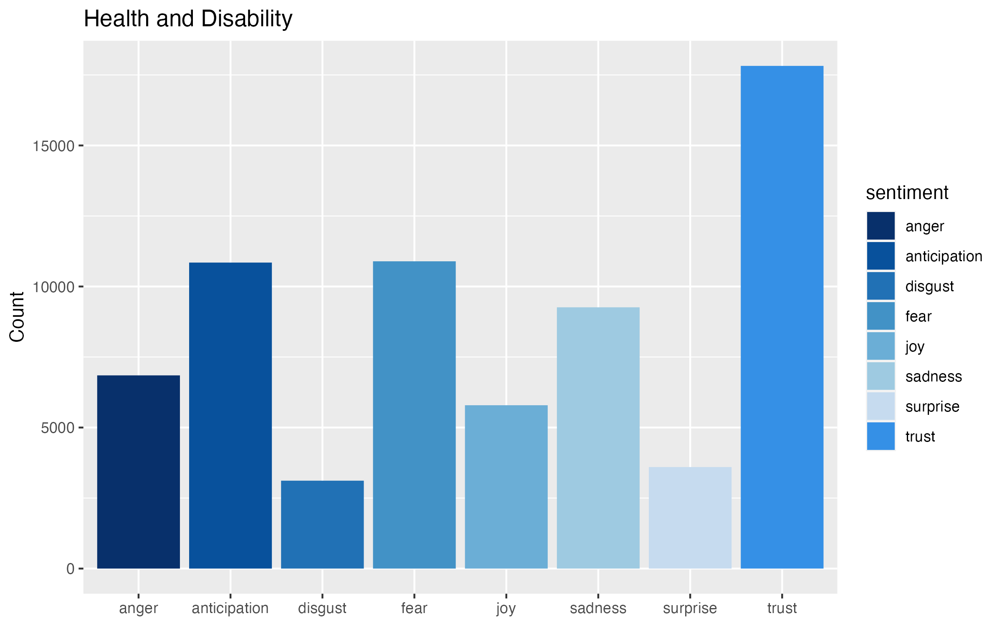

Slide 35
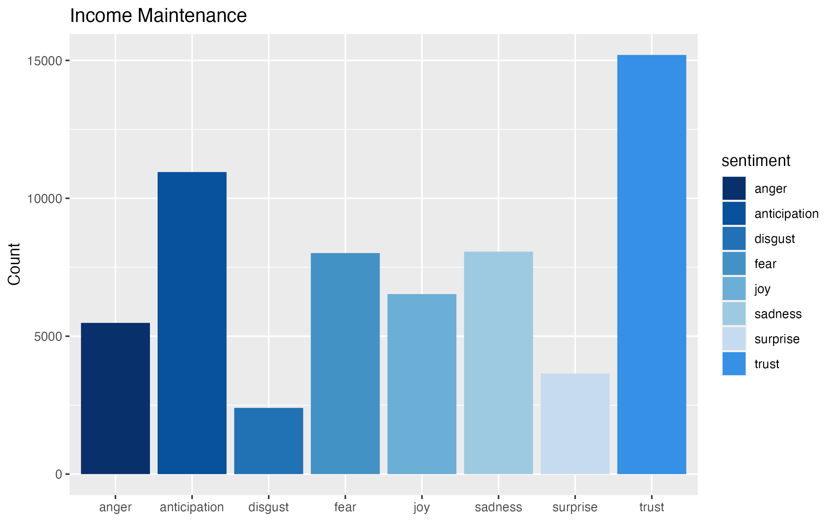

Slide 36
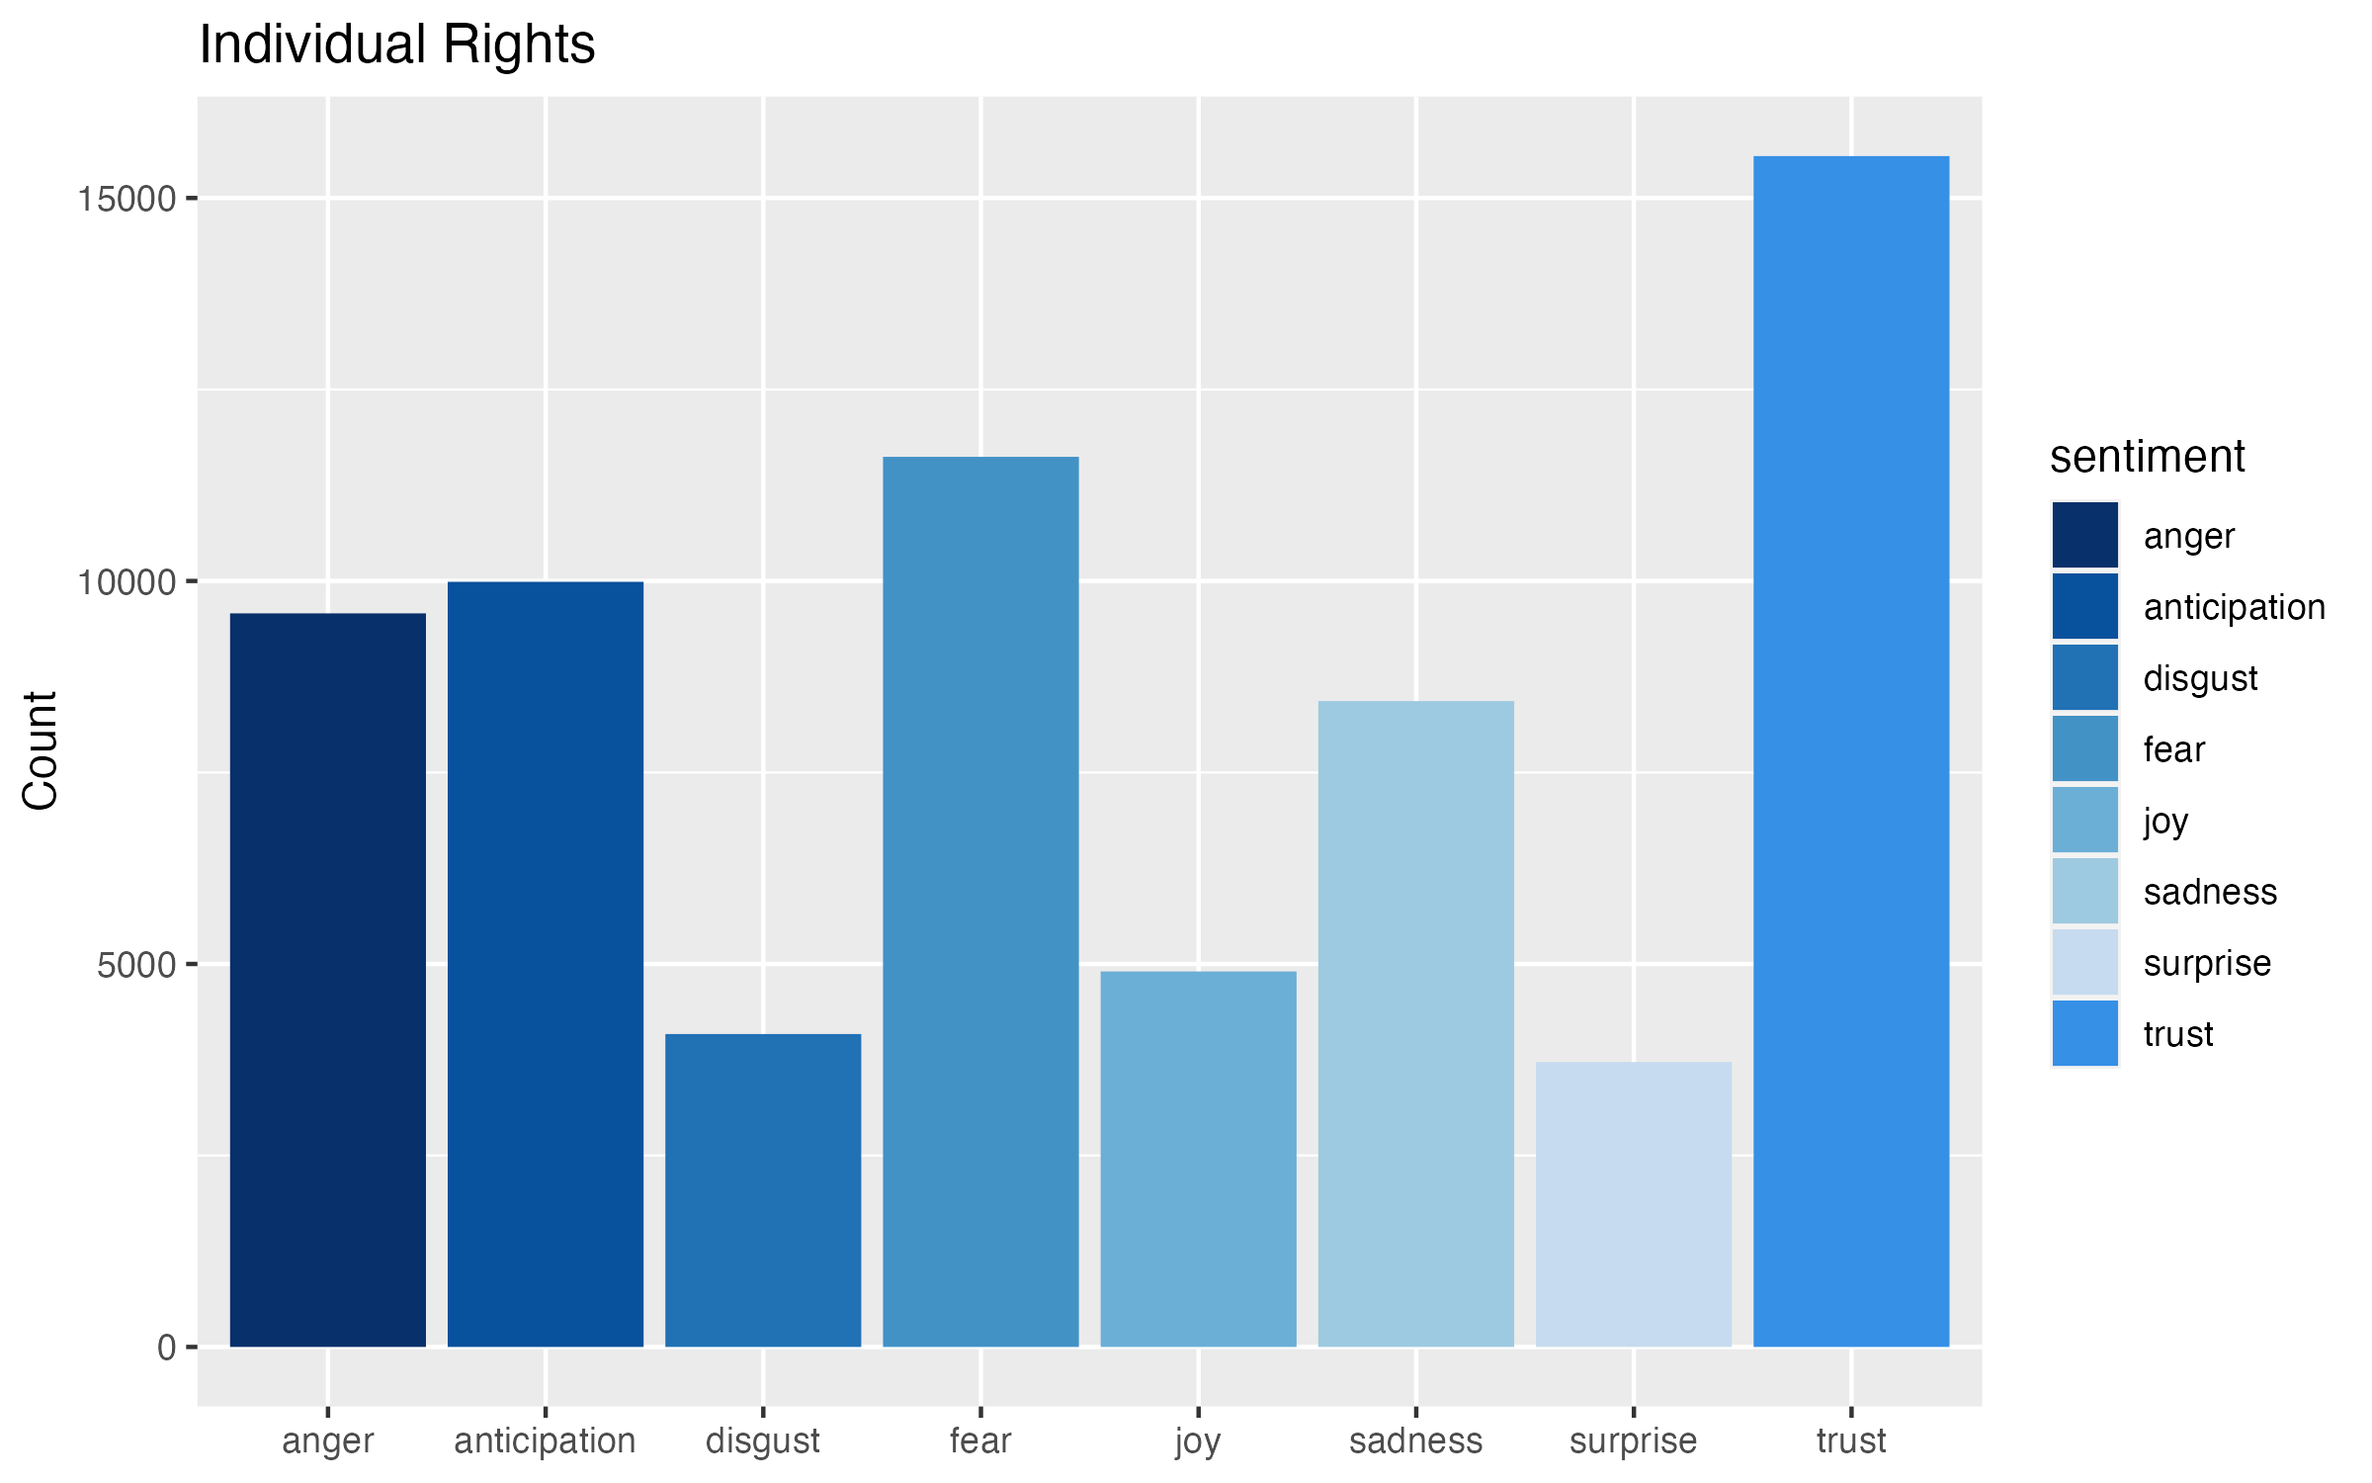

Slide 37
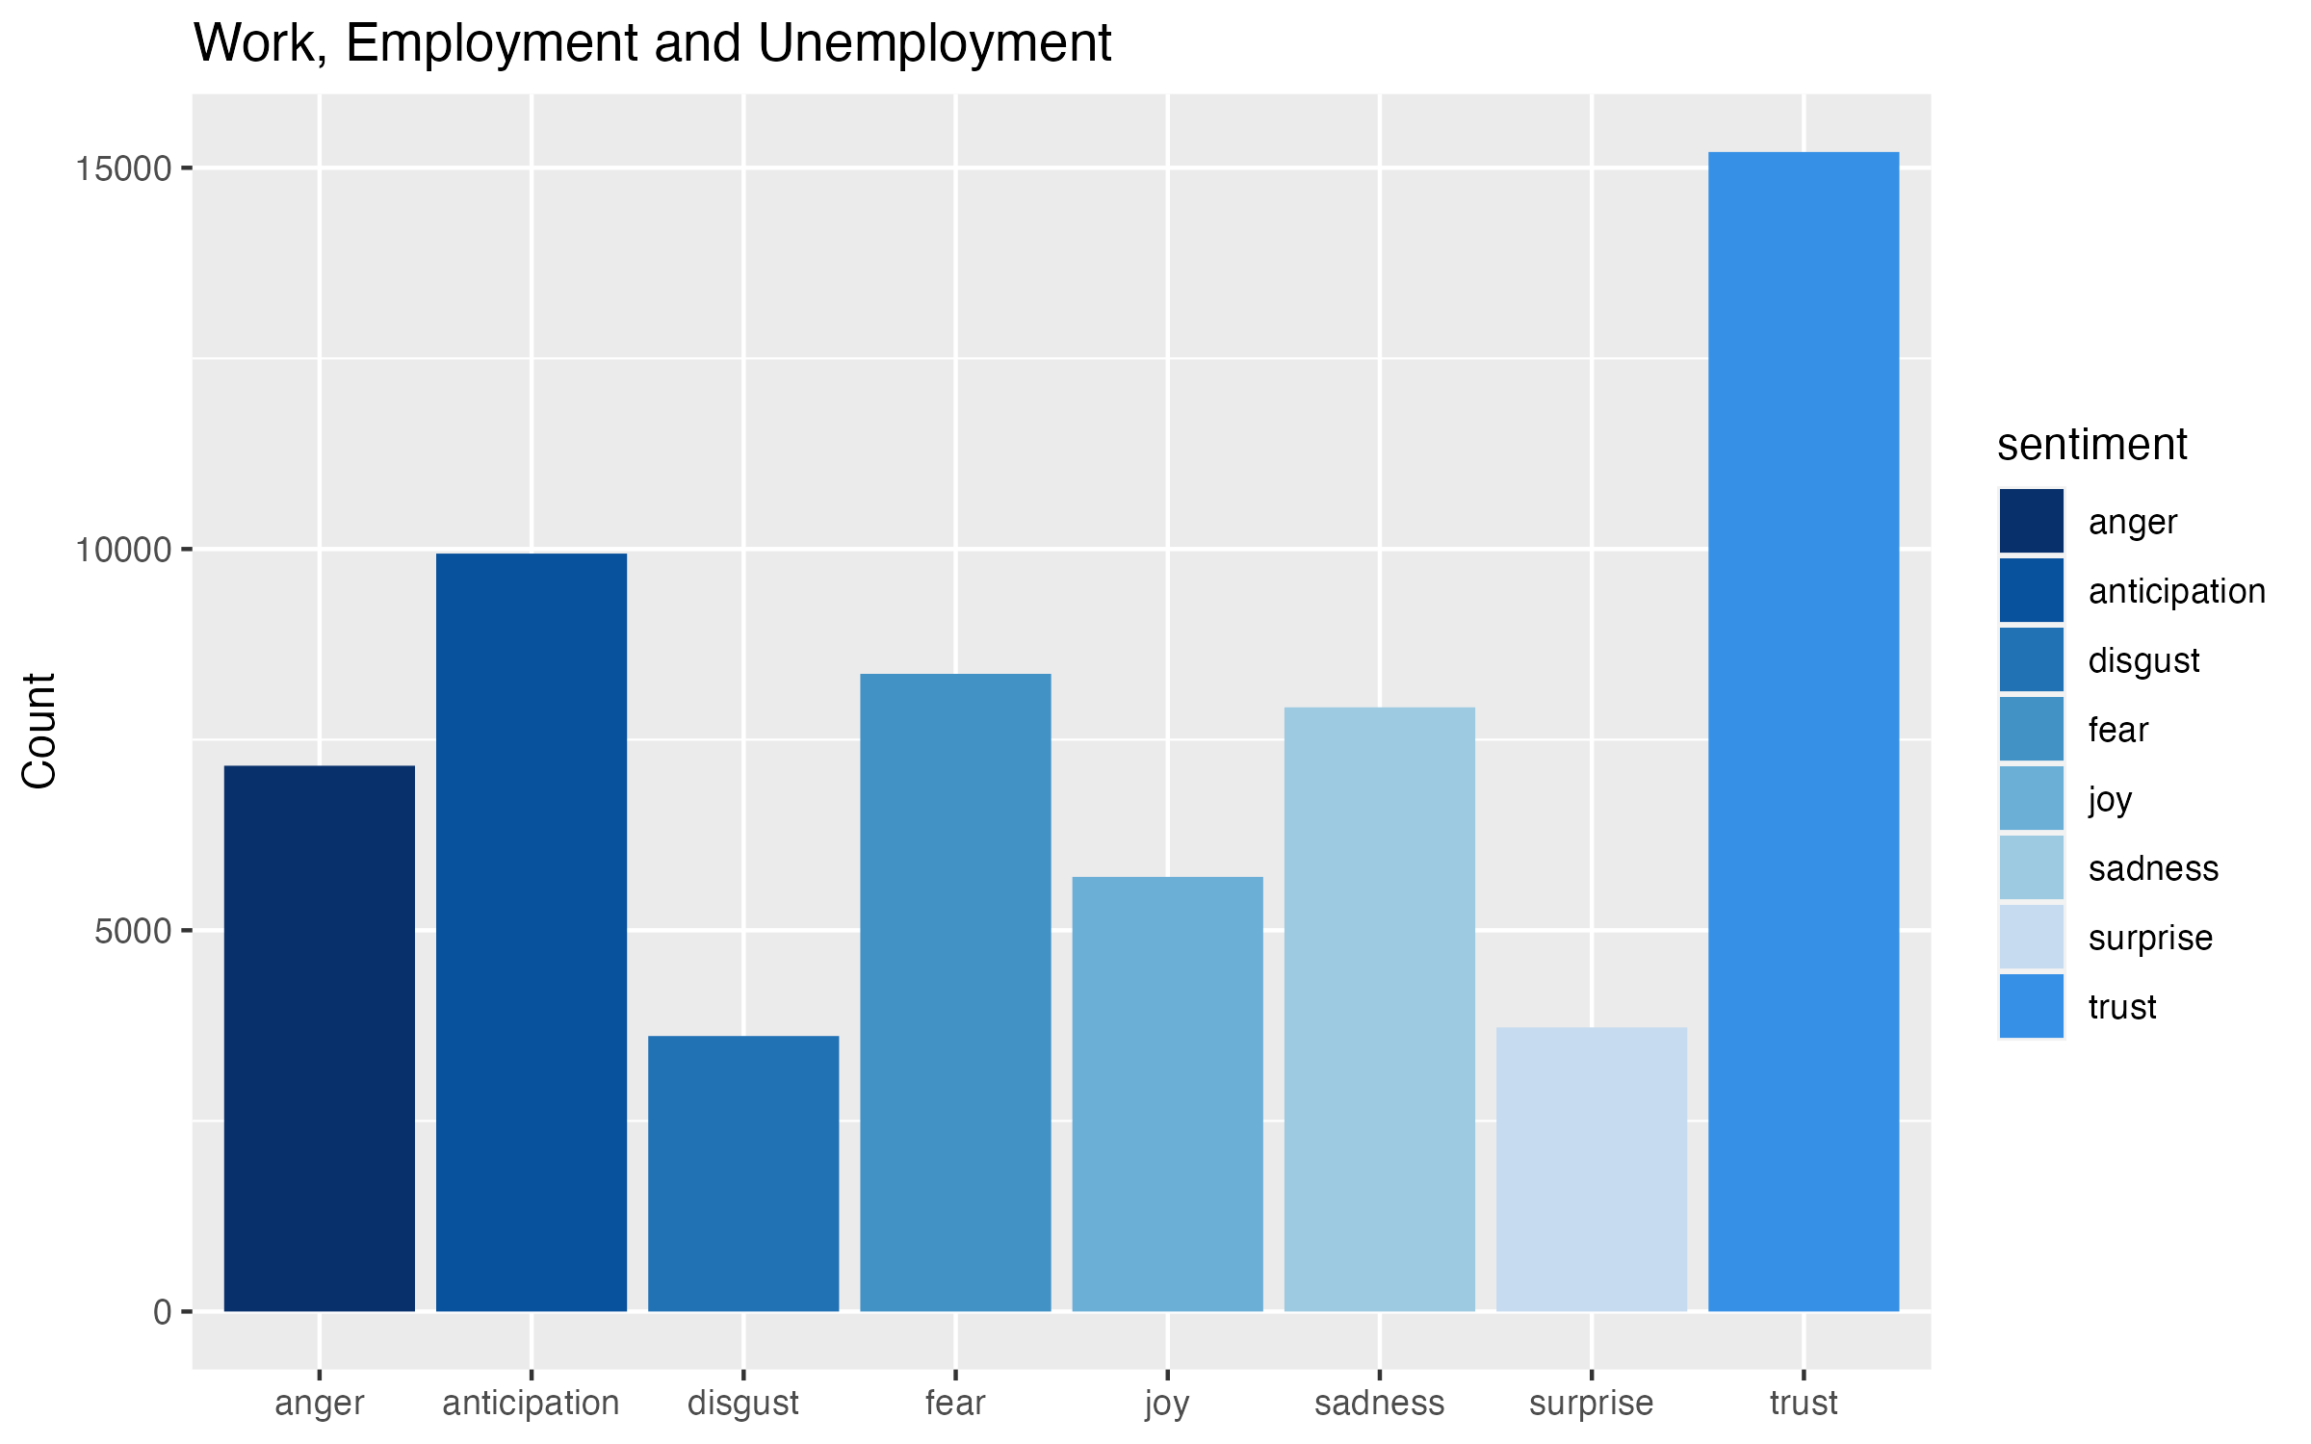

Slide 38
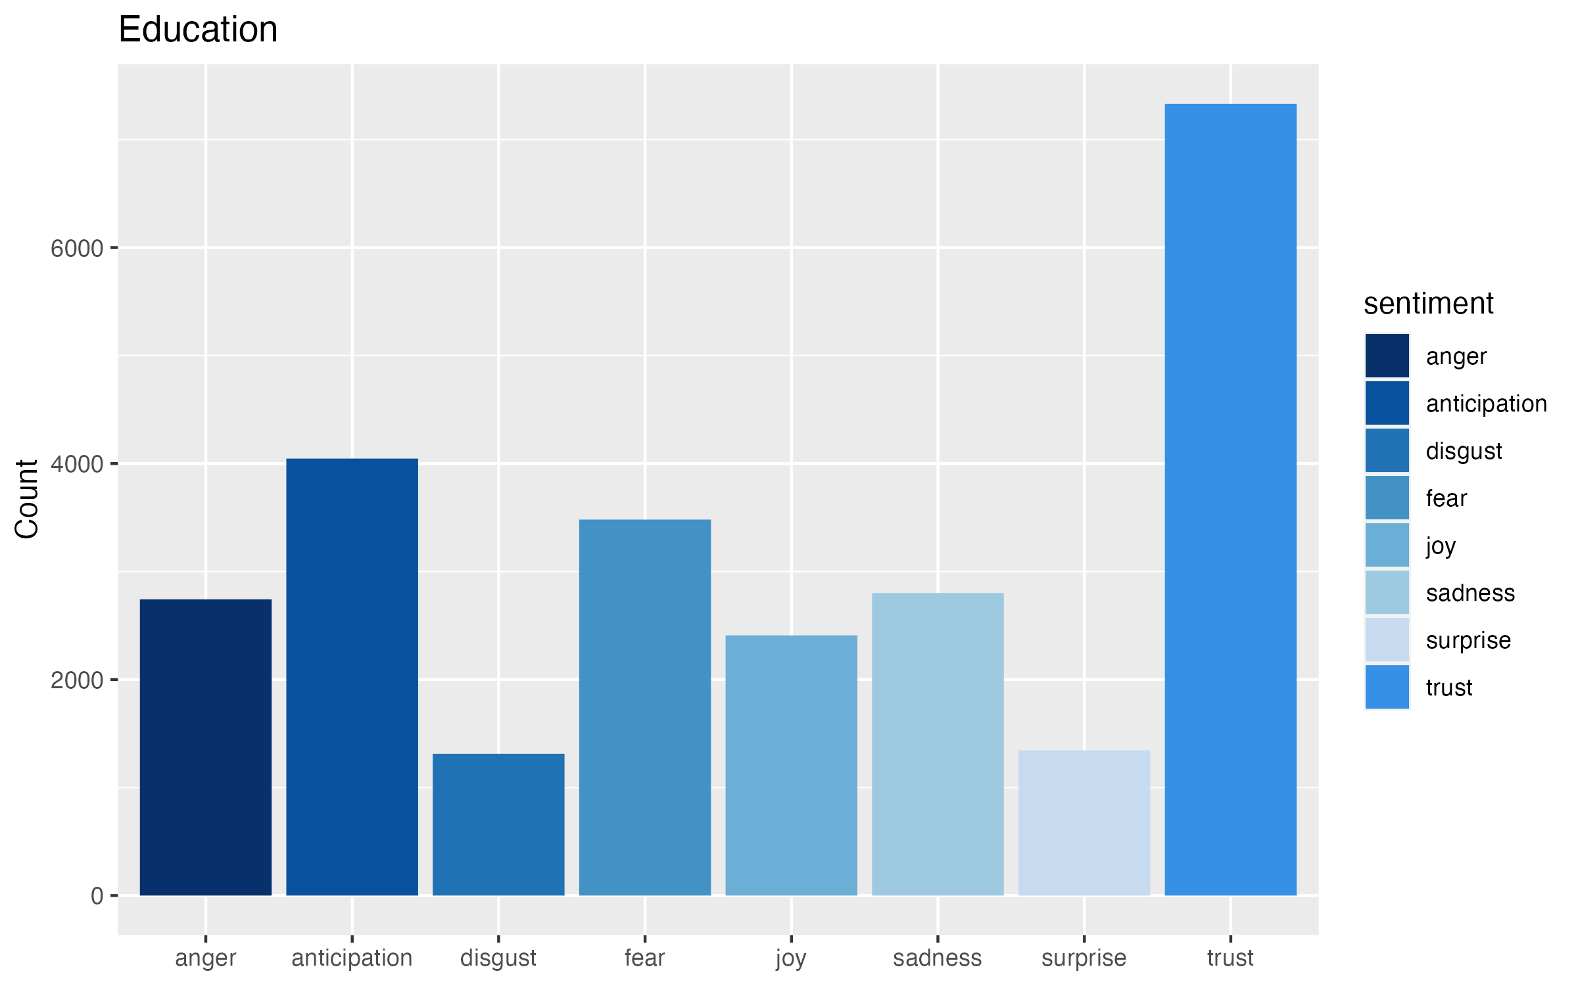

Slide 39
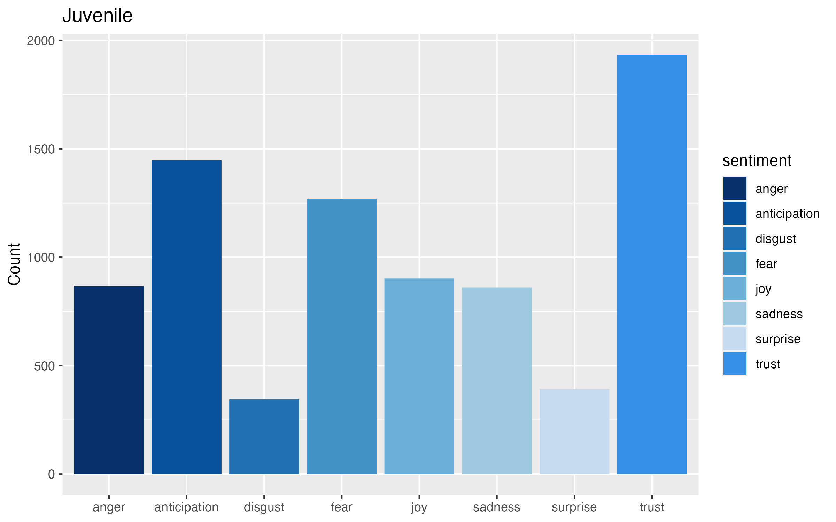

Slide 40
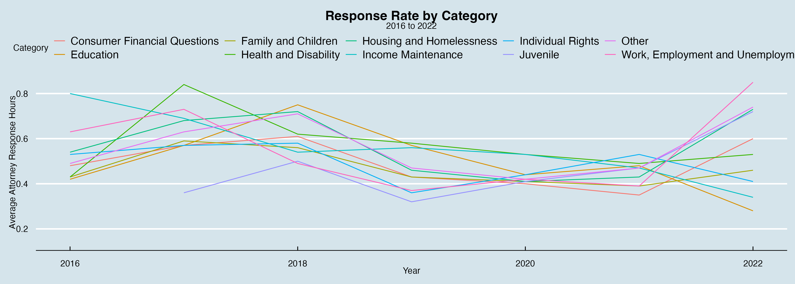

Slide 41
CONSULTING
Most common categories: Family and Children, Housing and Homeless, Consumer Finanacial Questions
Great trust for company → aim to reduce anticipation, especially in Juvenile & Family and Children
Promote that service protect individual rights (constitutional vs human rights)
Improve Response Hour in Work, Employment, and Unemployment, and three main common categories

Slide 42
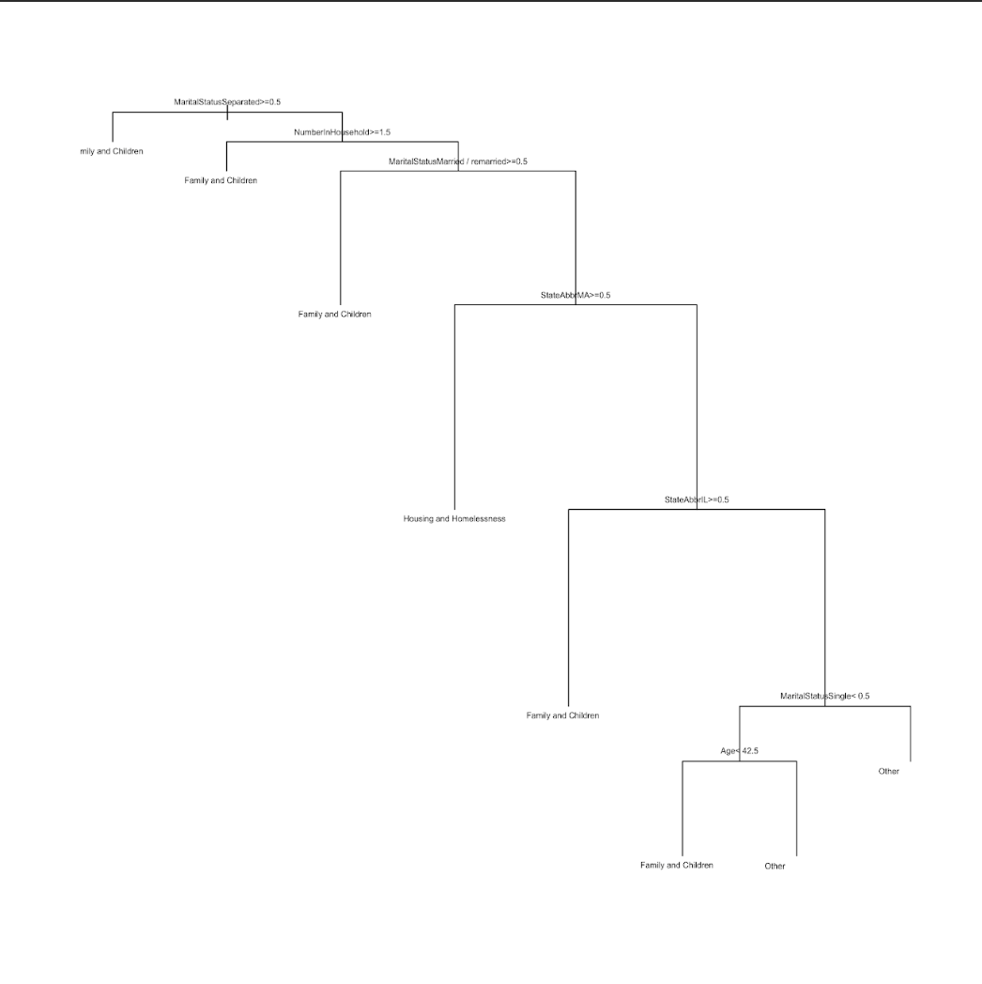
ML Model Decision Tree

Slide 43
SUMMARY
• We use correlation matrix to choose the variables of interest.
• We aim to use classification for category
• Some important findings:
The variables of interest: StateAbbr, EthnicIdentity, Age, Gender, MaritalStatus, Veteran, NumberInHousehold, Annual Income, and GetReplied (whether client get replied for their question post)
The most asked category is family and children.
Those whose marital status is “separated” or “married/remarried” with the number of members in the household > 1.5 tend to be the usual clients for the aforementioned category.

